Slide 1
TSSRD: A TOPIC SENTIMENT SUMMARIZATION FRAMEWORK BASED ON REACHING DEFINITION
MEMBERS:
T.AJAY KUMAR (202006005)
P. RAJA ATHIBAN (202006036)
P.K. VASANTH RAMM (202006254)
GUIDE:Mrs.S.AISHWARYA, ME

Slide 2
AIM
The Topic Sentiment Summarization Framework based on Reaching Definition (TSSRD) as a proposed solution to improve the quality of text summarization by incorporating sentiment analysis and considering changes in sentiments across sentences and documents.
Utilizing the Latent Dirichlet Allocation (LDA) for effective topic modeling in document analysis
Notes:
2

Slide 3
OBJECTIVES
Enhancing traditional sentiment-based text summarization methods by considering changes in sentiments within sentences and across the entire document.
Proposing and describing the TSSRD“ framework, which incorporates topic models and reaching definition techniques to create topic sentiment summaries.
Notes:
3

Slide 4
PROBLEM STATEMENT
The limitations of existing sentiment-based text summarization methods, which primarily focus on sentiment polarity in isolated sentences or complete documents and do not consider the sentiment changes throughout the document
The need to incorporate sentiment analysis into text summarization to produce higher-quality summaries.
The issue of information overload in daily life, necessitating the development of efficient text summarization technology.

Slide 5
LITERATURE SURVEY 1. SenticNet-6 Ensemble Application of Symbolic & Sub-Symbolic Systems Of AI
Integrated top-down and bottom up learning via an ensemble of symbolic and sub symbolic AI Tools Which is applied to the problem of polarity detection of Text.
Integrated logical reasoning with deep learning architectures to built the SenticNet-6
Use Case – Sentiment embeddings Calculation

Slide 6
2. Sentiment Analysis of Lockdown in India During COVID -19 : A Case Study On Twitter
In This Paper the preprocessing of Twitter is done using the Natural Language Processing Tool Kit provided by Python and eight different classifiers are used to classify the data.
Among the eight Classifiers, The Linear-SVC classifier outperforms.
Use Case – Preprocessing Techniques such as Tokenization , Stop word Removal ,Lemmatization and Stemming .

Slide 7
3. Improving the Performance of Sentiment Analysis Using Enhanced Preprocessing Technique
In This Paper , The proposed a new preprocessing steps that differs form existing preprocessing steps. The Proposed Preprocessing Outperforms and Give better accuracy than models with existing preprocessing methods.
Use Case – Using Enhanced Preprocessing in TSSRD To enhance accuracy of summaries.

Slide 8
4. Topic modeling combined with classification technique for extractive multi-document text summarization
Integration of topic modeling and classification techniques can lead to more relevant extractive summarization by identifying key themes and selecting sentences that align with those themes.
The approach might be adaptable to various domains, allowing for effective summarization in different contexts.
The effectiveness of classification techniques often depends on the quality and representativeness of the training data, which could impact generalizability.
Use Case – Using Topic Model [ LDA Topic Model ] in TSSRD

Slide 9
5. An extractive text summarization approach using tagged-LDA based topic modeling
Tagged-LDA based topic modeling may lead to improved identification of key topics, facilitating the extraction of topic-relevant sentences for summarization.
The approach may provide a more semantically informed summary by leveraging tagged-LDA, capturing not only topics but also nuanced relationships between words with tags.
Implementing tagged-LDA may introduce additional complexity in the summarization algorithm, potentially making it challenging to implement or requiring more computational resources.

Slide 10
COMPARISON
REFERENCE PAPER | COMPARISON
A new graph-based extractive text summarization using keywords or topic modeling | Selected Top K words under each topic as keywords according to the topic word distribution. Then Calculated The Similarities Between the sentences. WordNet is used to calculate edge weights in the graph. In TSSRD, the concept of sentiment neutralization & superposition , the weights of edges is calculated.

Slide 11
REFERENCE PAPER | COMPARISON
Aspect Based Sentiment Oriented Summarization Of Hotel Reviews | In This reference paper, Sentic Word-Net is used to Calculate sentiment scores according to the words in the sentences. And Selected Top k scores from each sentiment type as summaries In TSSRD, The Sentiment Scores are calculated Using SenticNet-6 which provides sentiment scores with additional details such as temper, sensitivity , introspection , mood-tags & sentiment label and summaries generated based on RD

Slide 12
REFERENCE PAPER | COMPARISON
Document Summarization via self present sentence relevance model | In This reference paper, they proposed the self present sentence relevance Algorithm, which uses cosine similarity of two sentences as edge weights and selected sentences according to their contribution to weights of all edges connected to them In TSSRD , sentiment neutralization concept which has two methods such as static and dynamic average weighted method is used to calculate edge weights

Slide 13
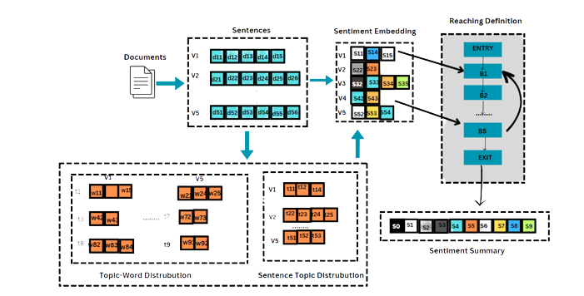
OVERALL WORK FLOW

Slide 14
Workflow of the TSSRD
Preprocessing of documents using a topic model.
Obtaining sentence-topic distribution and topic-word distribution.
Calculating sentiment embeddings for each topic.
Analyzing document structures based on the sentence-topic distribution.
Using improved reaching definition to analyze sentiment changes and flow
Finalizing the topic sentiment summary in steady states of the reaching definition.

Slide 15
MODULES
Task Definition
Document Representation Module
Sentiment Calculation Module
Reaching Definition Analysis Module
Summary Generation Module

Slide 16
MODULE DESCRIPTION
TASK DEFINITION
The TSSRD aims to summarize single-document texts
Input: Document with sentences
Analyzing sentiment at sentence level using topic models
Calculating topic sentiments based on topic-word distribution
Analyzing local sentiment changes between sentences
Analyzing global sentiment flow across the entire document
Output: Sentiment embedding summary, different from natural language summaries

Slide 17
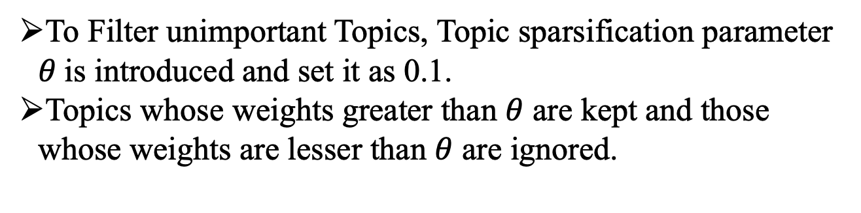
Document Representation Module
The TSSRD framework uses topic models to model documents at sentence level.
Each sentence in a document is represented as sentence-topic distribution and topic-word distribution.
The topic sentiments of sentences will be further calculated in the subsequent modules
Topic Sparsification Parameter
To Filter unimportant Topics, Topic sparsification parameter $θ$is introduced and set it as 0.1.
Topics whose weights greater than $θ$ are kept and those whose weights are lesser than $θ$ are ignored.

Slide 18
Sentiment Calculation Module
Calculating topic sentiments using a sentiment dictionary
Sentiment dictionary contains sentiment embeddings for many words and phrases
Utilizing query operation to obtain sentiment embeddings for words under each topic

Slide 19
Reaching Definition Analysis Module
TSSRD framework uses the reaching definition analysis module
Analyzes sentiment changes between sentences and sentiment flow in whole documents
Divided into two sub-modules: sentiment flow diagram design and sentiment flow analysis.
Sentiment Flow Diagram Design Module
Sub-module in the TSSRD framework: Analyzing document structures from the reader's and writer's perspectives
Reveal change regularities and flow paths of sentiments to design a sentiment flow diagram

Slide 20
Document structures are parsed into three common categories: total-sub, sub-total, and circular structures
Document structure analysis leads to the creation of a tree-like structure with nodes, variables, and sentiment embeddings
The sentiment flow diagram can have a single-path or multi-path structure depending on reader or writer perspective
Sentiment flow paths can vary between readers and writers, with readers following a different path compared to writers, leading to single-path and multi-path sentiment flow structures.

Slide 21
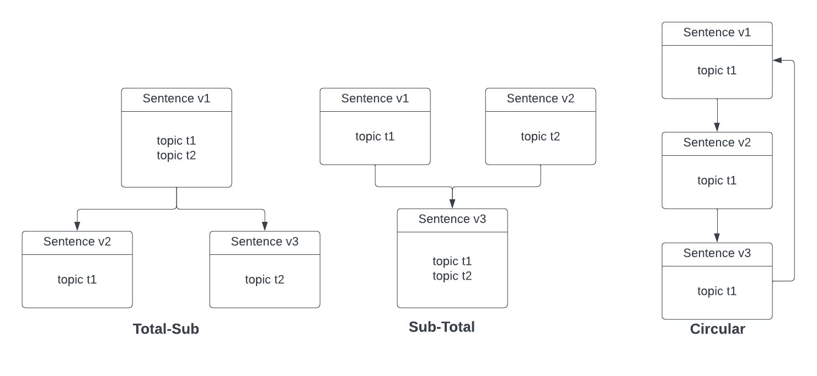

Slide 22
Sentiment Flow Analysis Module
Sub-module analyzes sentiment changes and sentiment flow using the designed sentiment flow diagram.
Traditional reaching definition involves a "kill" process where assignments are replaced, but sentiments require a more gradual approach.
Instead of direct replacement, new assignments are recalculated by incorporating both sentences assignments.
Introduction of sentiment weights for sentences based on their position in the document.
Design of three weighted average methods for sentiment analysis: sentiment neutralization and sentiment superposition, taking into account backward sentence positions.

Slide 23
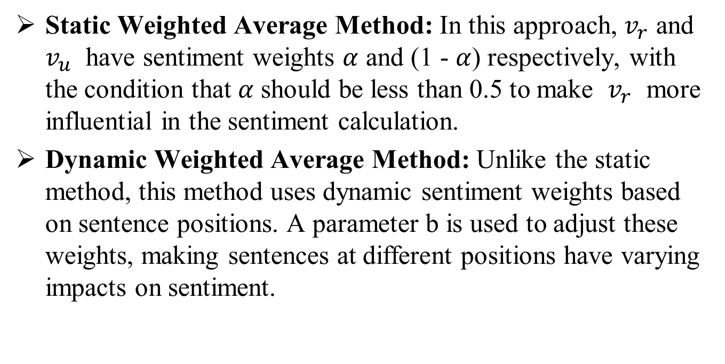
Sentiment Neutralization
Static Weighted Average Method: In this approach, $v_{r}$ and $v_{u}$ have sentiment weights $α$ and (1 - $α$) respectively, with the condition that$α$ should be less than 0.5 to make $v_{r}$ more influential in the sentiment calculation.
Dynamic Weighted Average Method: Unlike the static method, this method uses dynamic sentiment weights based on sentence positions. A parameter b is used to adjust these weights, making sentences at different positions have varying impacts on sentiment.

Slide 24
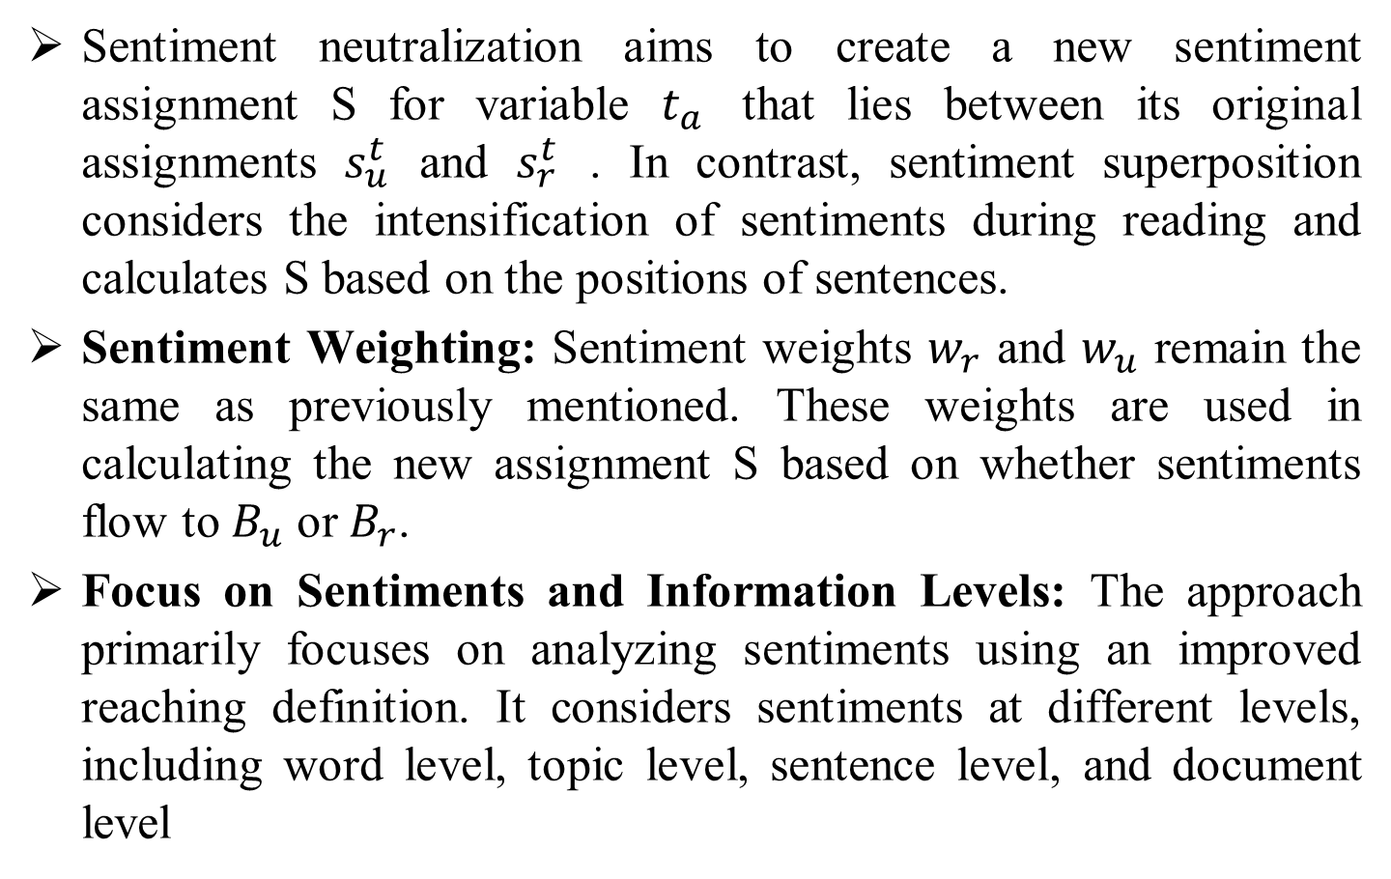
Sentiment Superposition
Sentiment neutralization aims to create a new sentiment assignment S for variable $t_{a}$ that lies between its original assignments $s_{u}^{t}$ and $s_{r}^{t}$ . In contrast, sentiment superposition considers the intensification of sentiments during reading and calculates S based on the positions of sentences.
Sentiment Weighting: Sentiment weights $w_{r}$ and $w_{u}$ remain the same as previously mentioned. These weights are used in calculating the new assignment S based on whether sentiments flow to $B_{u}$ or $B_{r}$.
Focus on Sentiments and Information Levels: The approach primarily focuses on analyzing sentiments using an improved reaching definition. It considers sentiments at different levels, including word level, topic level, sentence level, and document level

Slide 25
Summary Generation Module
The Summary generation module is used to generate final topic summaries. When sentiments in each node reach steady states of Reaching Definition.
Taken Output of the last node as final topic sentiment summary.
To Evaluate the summaries , SVM classifier is used .

Slide 26
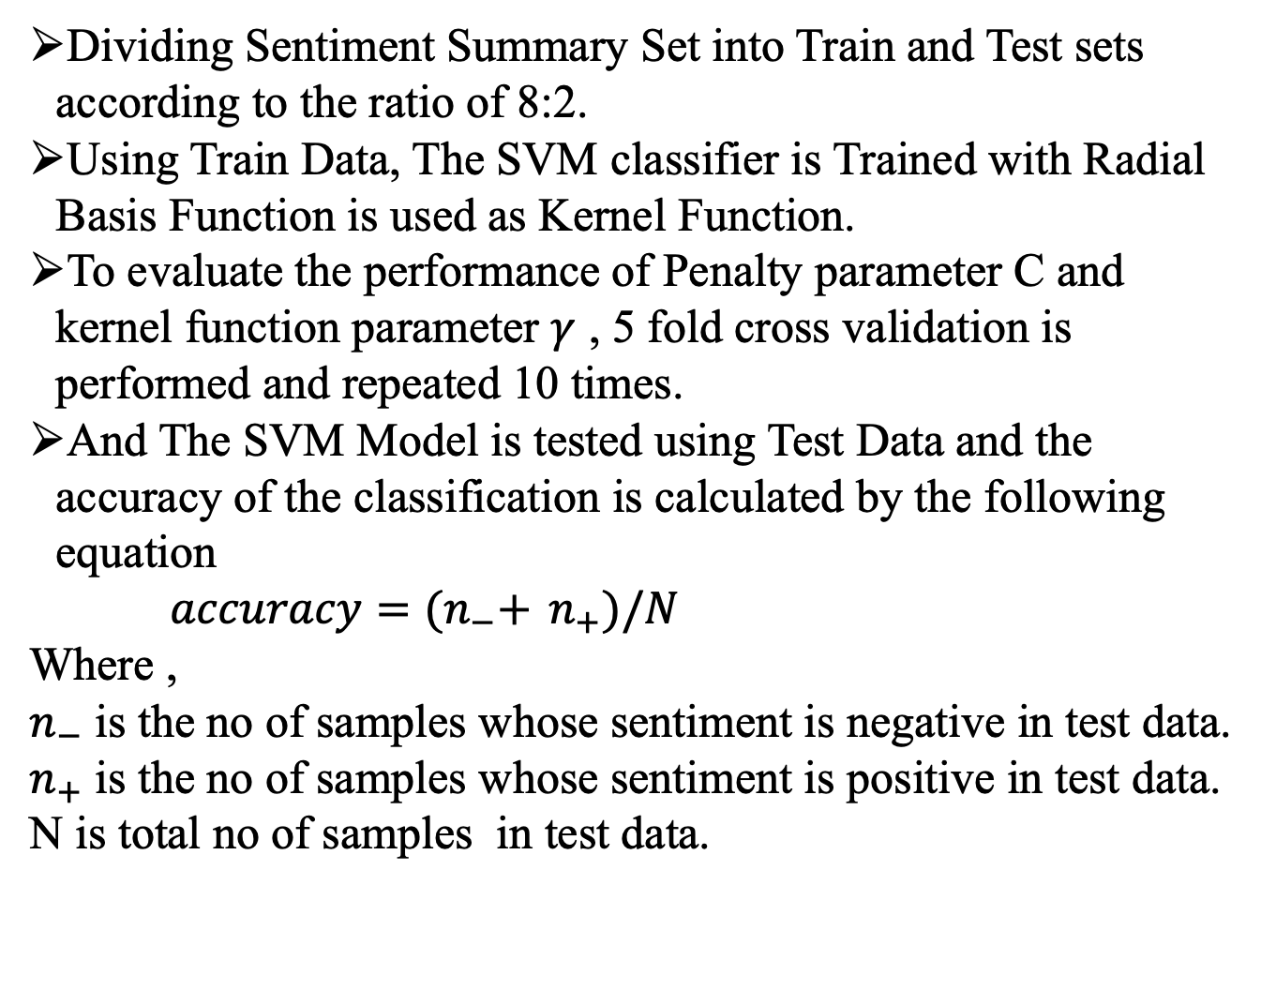
Evaluation
Dividing Sentiment Summary Set into Train and Test sets according to the ratio of 8:2.
Using Train Data, The SVM classifier is Trained with Radial Basis Function is used as Kernel Function.
To evaluate the performance of Penalty parameter C and kernel function parameter $γ$ , 5 fold cross validation is performed and repeated 10 times.
And The SVM Model is tested using Test Data and the accuracy of the classification is calculated by the following equation
$accuracy={(n}_{−}+$ $n_{+})/N$
Where ,
$n_{−}$ is the no of samples whose sentiment is negative in test data.
$n_{+}$ is the no of samples whose sentiment is positive in test data.
N is total no of samples in test data.

Slide 27

FORMULAE USED
$S^{e}$ = query(e)
$S_{ij}^{e}$ = query($e_{ij}$) $S_{ij}^{e}$ $∈$ $ℝ^{|D|}$
$S_{ij}^{t}$ = $\frac{1}{t_{j}}$ $\sum_{e_{ij} ∈t_{j}}{\text{query}\text{(}e_{ij}\text{)}}$

Slide 28
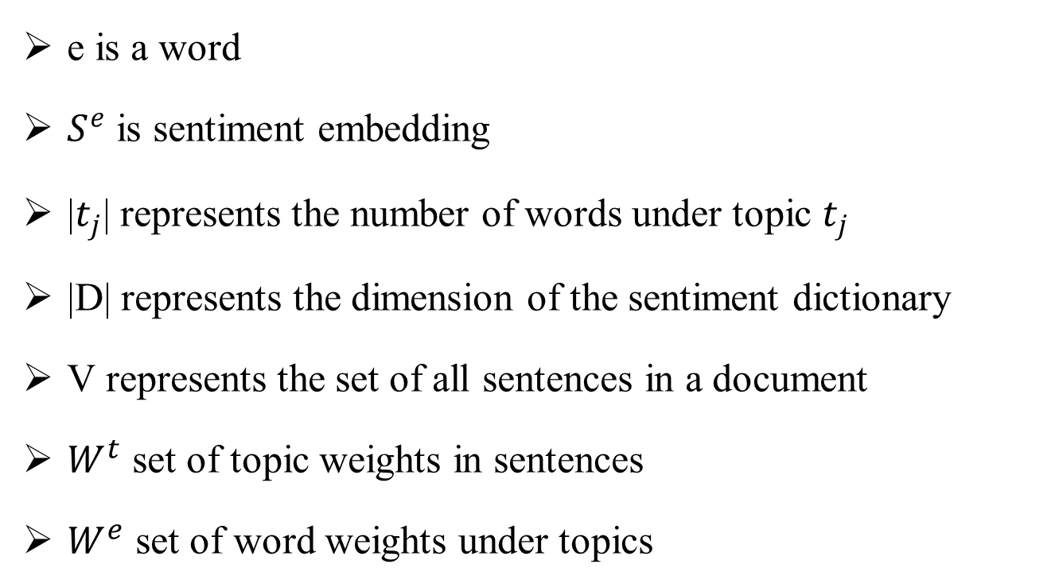
DESCRIPTION
e is a word
$S^{e}$ is sentiment embedding
|$t_{j}$| represents the number of words under topic $t_{j}$
|D| represents the dimension of the sentiment dictionary
V represents the set of all sentences in a document
$W^{t}$ set of topic weights in sentences
$W^{e}$ set of word weights under topics

Slide 29
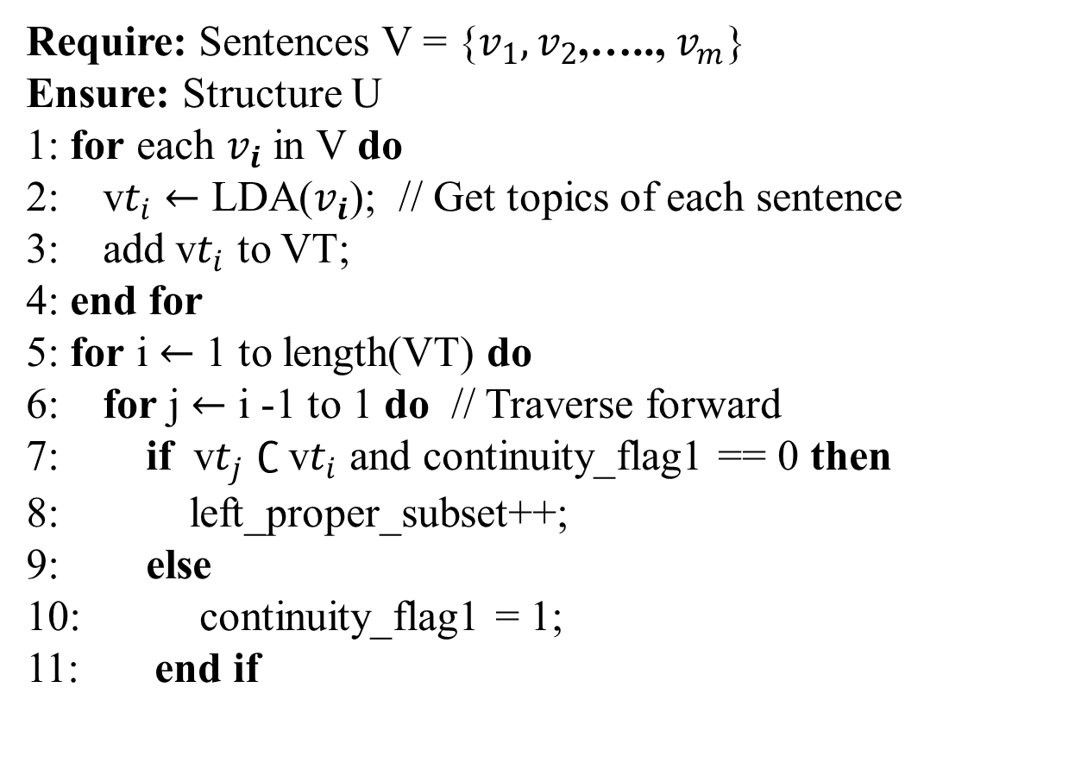
ALGORITHM
Algorithm 1.Document Structure Analysis
Require: Sentences V = {$v_{1},v_{2}$,….., $v_{m}$}
Ensure: Structure U
1: for each $v_{i}$ in V do
2: v$t_{i}$ $←$ LDA($v_{i}$); // Get topics of each sentence
3: add v$t_{i}$ to VT;
4: end for
5: for i $←$ 1 to length(VT) do
6: for j $←$ i -1 to 1 do // Traverse forward
7: if v$t_{j}$ $∁$v$t_{i}$ and continuity_flag1 == 0 then
8: left_proper_subset++;
9: else
10: continuity_flag1 = 1;
11: end if

Slide 30
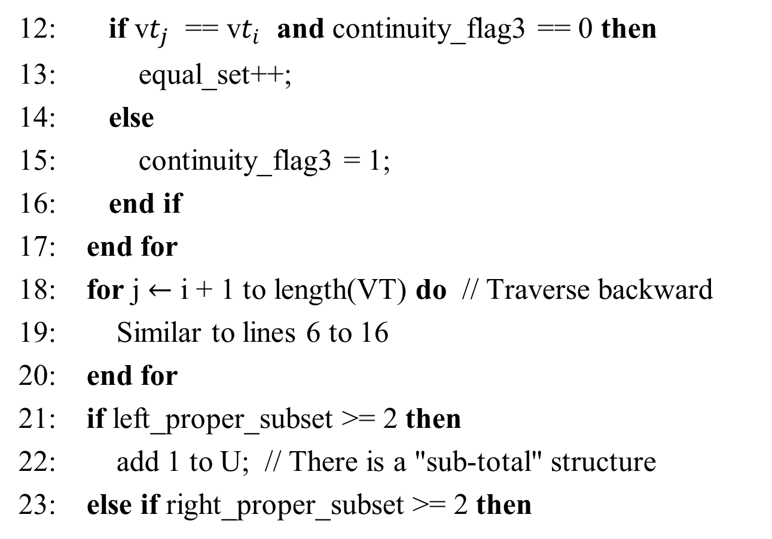
12: if v$t_{j}$ == v$t_{i}$ and continuity_flag3 == 0 then
13: equal_set++;
14: else
15: continuity_flag3 = 1;
16: end if
17: end for
18: for j $←$ i + 1 to length(VT) do // Traverse backward
19: Similar to lines 6 to 16
20: end for
21: if left_proper_subset >= 2 then
22: add 1 to U; // There is a "sub-total" structure
23: else if right_proper_subset >= 2 then

Slide 31
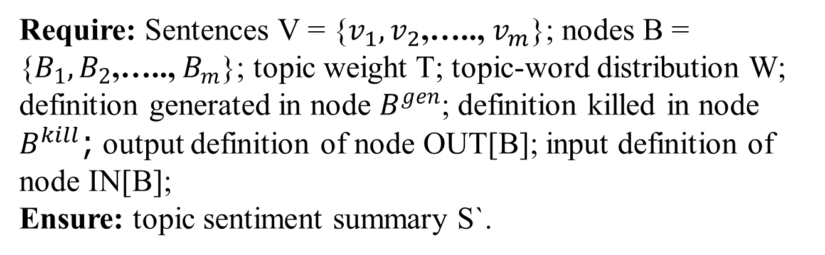
24: add 2 to U; // There is a "total-sub" structure
25: else if equal_set >= 2 then
26: add 3 to U; // There is a circular structure
27: end if
28: end for
29: remove duplicate elements from U;
Algorithm 2.Topic Sentiment Summarization
Require: Sentences V = {$v_{1},v_{2}$,….., $v_{m}$}; nodes B = {$B_{1},B_{2}$,….., $B_{m}$}; topic weight T; topic-word distribution W; definition generated in node $B^{gen}$; definition killed in node $B^{kill}$; output definition of node OUT[B]; input definition of node IN[B];
Ensure: topic sentiment summary S`.

Slide 32
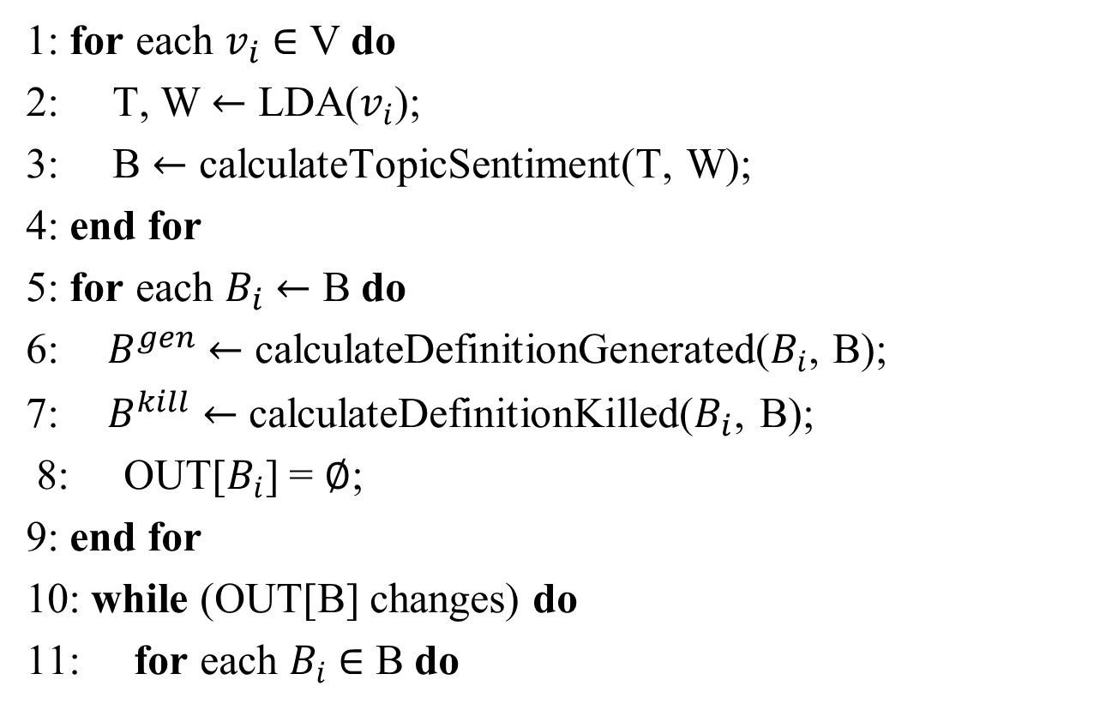
1: for each $v_{i}$ $∈$ V do
2: T, W $←$ LDA($v_{i}$);
3: B $←$ calculateTopicSentiment(T, W);
4: end for
5: for each $B_{i}$ $←$ B do
6: ${ B}^{gen} ←$ calculateDefinitionGenerated($B_{i}$, B);
7: $B^{kill}$ $←$ calculateDefinitionKilled($B_{i}$, B);
8: OUT[$B_{i}$] = $∅$;
9: end for
10: while (OUT[B] changes) do
11: for each $B_{i}$ $∈$ B do

Slide 33
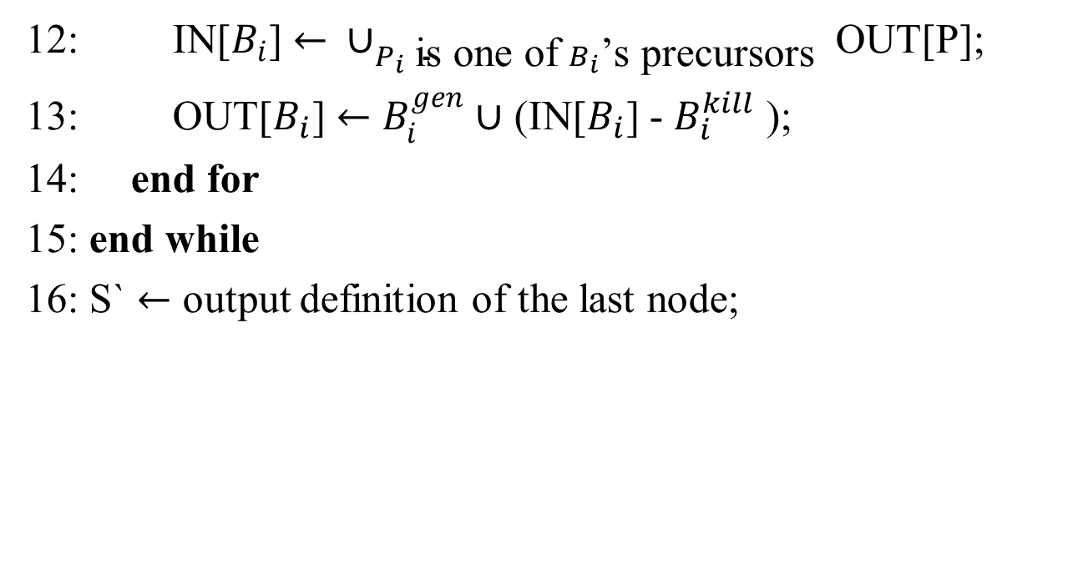
12: IN[$B_{i}$] $← ∪_{P_{i} \text{is} \text{one} \text{of} B_{i}\text{’}\text{s} \text{precursors} }\text{OUT}\text{[}\text{P}\text{]; }$
13: OUT[$B_{i}$] $←$ $B_{i}^{gen}$ $∪$ (IN[$B_{i}$] - $B_{i}^{kill}$ );
14: end for
15: end while
16: S` $←$ output definition of the last node;

Slide 34
Sample Input & Output
Sample Document
I went and saw this movie last night after being coaxed to by a few friends of mine. I'll admit that I was reluctant to see it because from what I knew of Ashton Kutcher he was only able to do comedy. I was wrong. Kutcher played the character of Jake Fischer very well, and Kevin Costner played Ben Randall with such professionalism. The sign of a good movie is that it can toy with our emotions. This one did exactly that. The entire theater (which was sold out) was overcome by laughter during the first half of the movie, and were moved to tears during the second half. While exiting the theater I not only saw many women in tears, but many full grown men as well, trying desperately not to let anyone see them crying. This movie was great, and I suggest that you go see it before you judge.

Slide 35
Step 1 –Document to Sentences [Tokenization]
I went and saw this movie last night after being coaxed to by a few friends of mine.
I'll admit that I was reluctant to see it because from what I knew of Ashton Kutcher he was only able to do comedy.
I was wrong.
Kutcher played the character of Jake Fischer very well, and Kevin Costner played Ben Randall with such professionalism.
The sign of a good movie is that it can toy with our emotions.
....
Totally 9 Sentences

Slide 36
Step 2 – Sentences To Words [Tokenization]
words ['I', 'went', 'and', 'saw', 'this', 'movie', 'last', 'night', 'after', 'being', 'coaxed', 'to', 'by', 'a', 'few', 'friends', 'of', 'mine']
Step 3 – Stop Words Removal And Lemmatization
words ['went', 'saw', 'movie', 'last', 'night', 'coaxed', 'friend', 'mine', ]

Slide 37
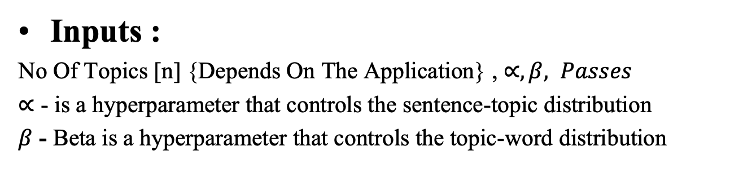
Step 4 – Vectorization
 | coaxed | friend | last | mine | movie | night | saw | went
Words | 1 | 1 | 1 | 1 | 1 | 1 | 1 | 1
Step 5 – Training LDA Topic Model
Inputs :
No Of Topics [n] {Depends On The Application} , $∝, β, Passes$
$∝$ - is a hyperparameter that controls the sentence-topic distribution
$β$ - Beta is a hyperparameter that controls the topic-word distribution

Slide 38
Step 6 – Use Trained LDA Topic Model to Get Topic- Word Distribution and Sentence Topic Distribution
Topic – Word Distribution
Topics | Words
#1 | ['well', 'theater', 'half', 'saw', 'many', 'kutcher', 'tear', 'played', 'see', 'movie']
#2 | ['full', 'go', 'good', 'great', 'grown', 'jake', 'judge', 'kevin', 'woman', 'wrong']
Sentence - Topic Distribution
Sentences | Topic #1 | Topic #2
1 | 0.99061403 | 0.00469298
…
9 | 0.99061403 | 0.00469298

Slide 39
Step 7 – Calculate Sentiment Embeddings
Inputs :
Sentences
Sentence-Topic Distribution
Topic-Word Distribution
Output
Sentiment Embeddings
Sentences | Sentiment Score | Topic
1 | 0.4767 | 1
2 | 0.3182 | 1
..
8 | -0.7469 | 0
9 | 0.6249 | 1

Slide 40
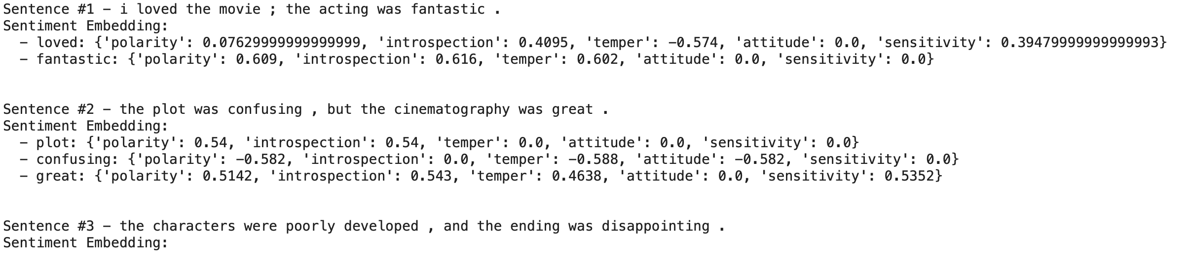

Slide 41
DATASETS
Amazon Electronics Datasets
IMDB Datasets

Slide 42
SOFTWARE REQUIREMENT
Google Colab
Pycharm

Slide 43
NOVELTY
Incorporating Other Topic Models such as Non Negative Matrix Factorization (NMF) and Latent Semantic Analysis (LSA).
Using LSTM ,Decision Tree for evaluation
Using Ensemble Learning such as random forest for better accuracy
Notes:
43

Slide 44
REFERENCE
[1] R. K. Roul focuses on "Topic modeling combined with classification technique for extractive multi-document text summarization" (2021).
[2] Z. Wu et al. present "A topic modeling based approach to novel document automatic summarization" (2017).
[3] N. Gialitsis et al. explore "A topic-based sentence representation for extractive text summarization" (2019).
[4] R. Rani and D. Lobiyal propose "An extractive text summarization approach using tagged-LDA based topic modeling" (2021).
[5] B. Xu et al. work on "Generating user-oriented text summarization based on social networks using topic models" (2016).
[6] A. Khurana and V. Bhatnagar investigate "Entropy for extractive document summarization" (2021).

Slide 45
THANK YOU
Notes:
45

